Slide 1
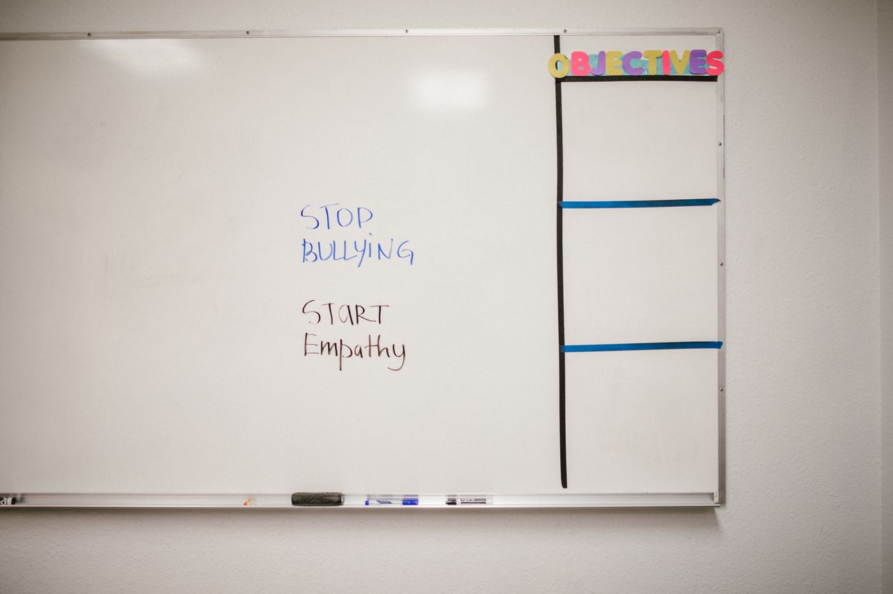
Stand Up.
Speak Up.
Grades 4–6
Together For Health

Slide 2

🛡️
What Is Bullying?
Bullying is when someone hurts another person on purpose, more than once, when there is a power difference.
Bullying is not normal or okay. Every student deserves to feel safe at school.
Together For Health

Slide 3
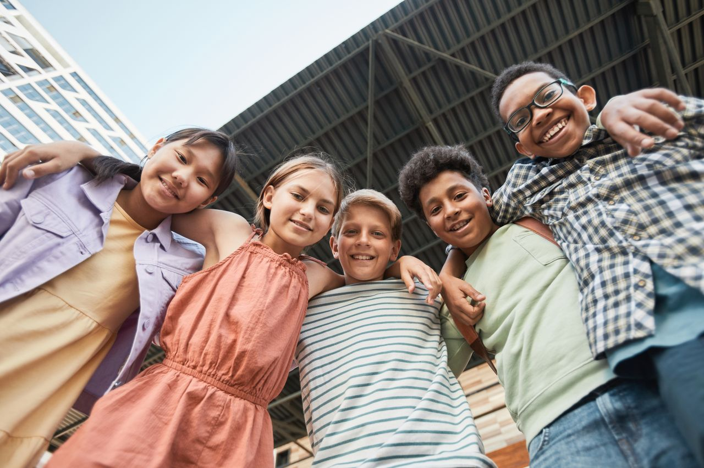
👁️
Types of Bullying
Physical: hitting, pushing, taking things
Verbal: name-calling, teasing, threats
Social: leaving someone out, spreading rumours
Cyberbullying: mean messages or posts online
Together For Health

Slide 4
💡
How to Help If You See Bullying
Do not join in — even laughing makes it worse
Support the person being bullied — sit with them, check in later
Report it to a trusted adult — this is NOT tattling
If it is safe, say "That is not cool" and walk away with the person
Your voice matters — bystanders have real power to stop bullying
Together For Health

Slide 5
🗣️
If You Are Being Bullied
You are not alone and it is not your fault
1
Tell a trusted adult: teacher, counsellor, parent
2
Write down what happened: date, time, what was said or done
3
Block and report on social media if it is cyberbullying
4
Try not to respond — engaging often makes it worse
5
Together For Health

Slide 6
KEY TAKEAWAYS
Bullying is never the victim's fault
✓
Asking for help is the right thing to do
✓
Together we make our school a safer place
✓
Resources
Kids Help Phone: 1-800-668-6868
PREVNet: prevnet.ca
Talk to a trusted adult at school today
Together For Health

